Slide 1




Data-Limited Fisheries Toolkit
Evaluating management strategies for data-limited fish species
What is DLMtool?
Lecture 1c, May 2017
Tom Carruthers & Adrian Hordyk .
Nicolas Gutierrez

Slide 2
Agenda
Overview of DLMtool
Case studies
Features
Correct usage
Future additions
Online demo

Slide 3
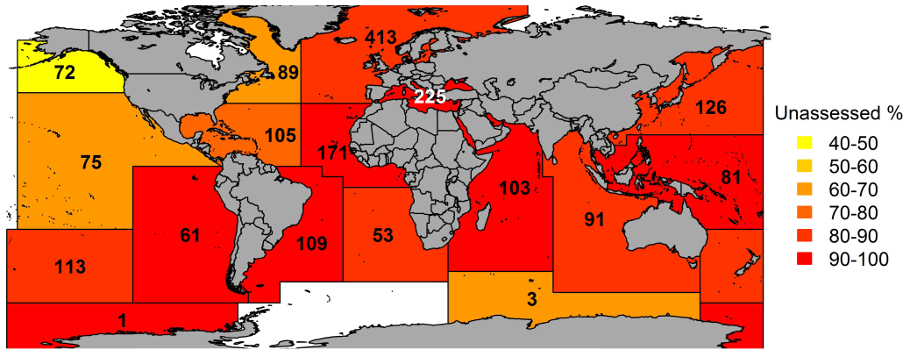
1. Overview
Approximately 90% of the world’s fisheries are lacking data to conduct a fishery stock assessment
Numbers represent the number of stocks in each region
Costello et al. 2014, UN FAO data

Slide 4

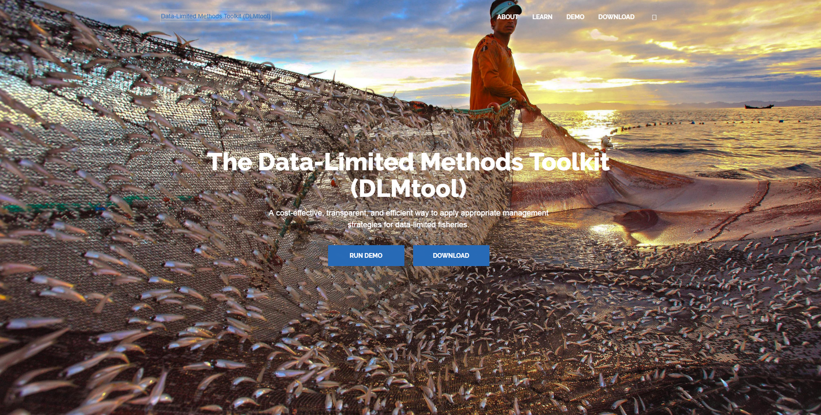

www.datalimitedtoolkit.org
V4.1 Carruthers & Hordyk 2017

Slide 5
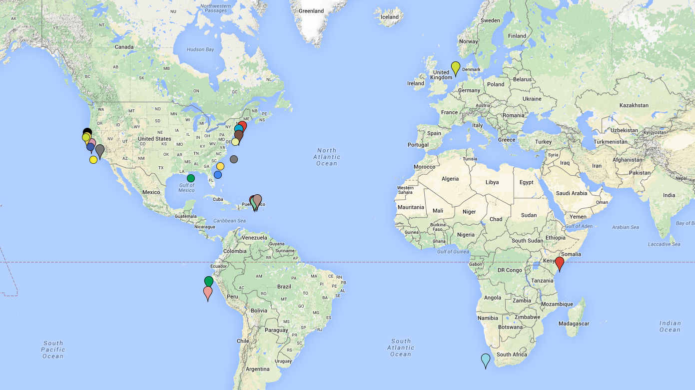
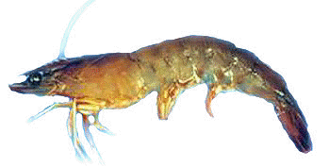
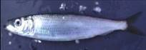




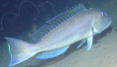
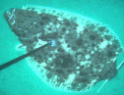


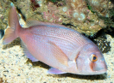

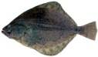


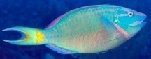



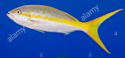
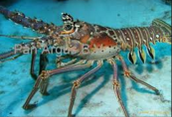
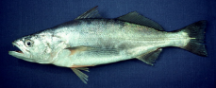
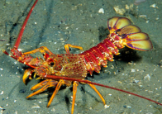


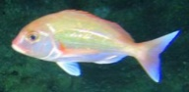
10,000+ 128 30+
management procedures
downloads fisheries

Slide 6
2. Case studies

Slide 7
2. Case studies continued

Slide 8
3. DLMtool features
Rapid operating model builder
100+ data-limited and data-moderate MPs
Value of information analytics
MP feasibility analysis
Convergence diagnostics
Performance graphing routines
Supporting functions (Operating models from SRA etc)
Customizable: easy to add new MPs, performance metrics
Highly flexible (embedded in R or easy I/O etc)
Parallel processing enabled (compatible with supercomputing)

Slide 9
4. Correct Usage
Considering Punt et al. (2015) best practices
Identify performance objectives first (but see Nakatsuka 2016)
Do not arbitrarily alter operating models to achieve objectives
Adopt MPs that have been tested
Selected MPs by MSE, not according to the magnitude of catches they provide given the current real data
Don’t change the MP that is being used in management unless there is an update in operating model or obvious catastrophe
If an MP is to be adopted, make sure that the assumptions of the MP are well understood

Slide 10
5. Future additions
Age-dependent M
Discarding rate and post-release survival
Additional data-rich MPs (state-space delay-difference)
Bioeconomic fleet models
Multispecies operating models
More complex spatial models
Ontogenetic habitat shifts
Hermaphroditism (sequential hermaphroditism)
Ecosystem models (MICE)
Automatic building of MPs that are ‘average-of-many-MPs’

Slide 11
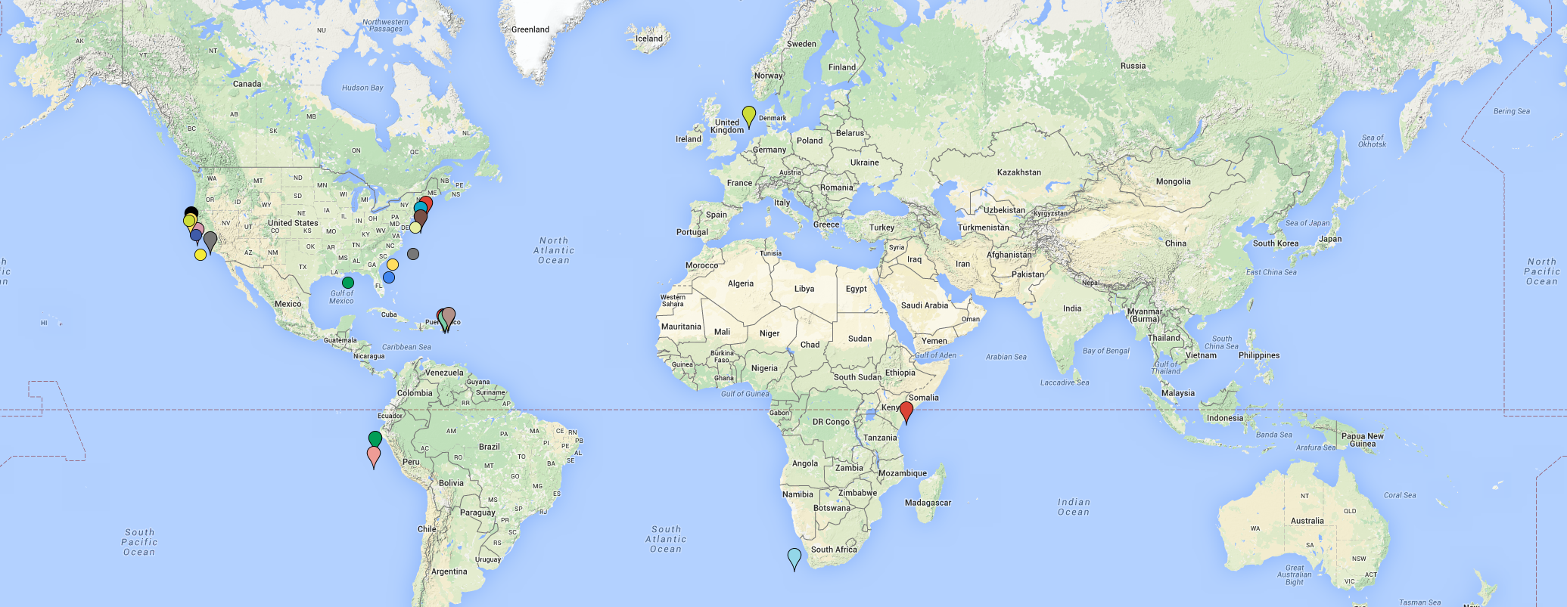




Future applications
Ongoing DLMtool applications
UN FAO: ABNJ tuna fisheries
Mexican near-shore fisheries
USA NOAA
California Dep. Fish. Wild.
Canadian Dep. Fish. Oceans.
Assorted proposals

Slide 12
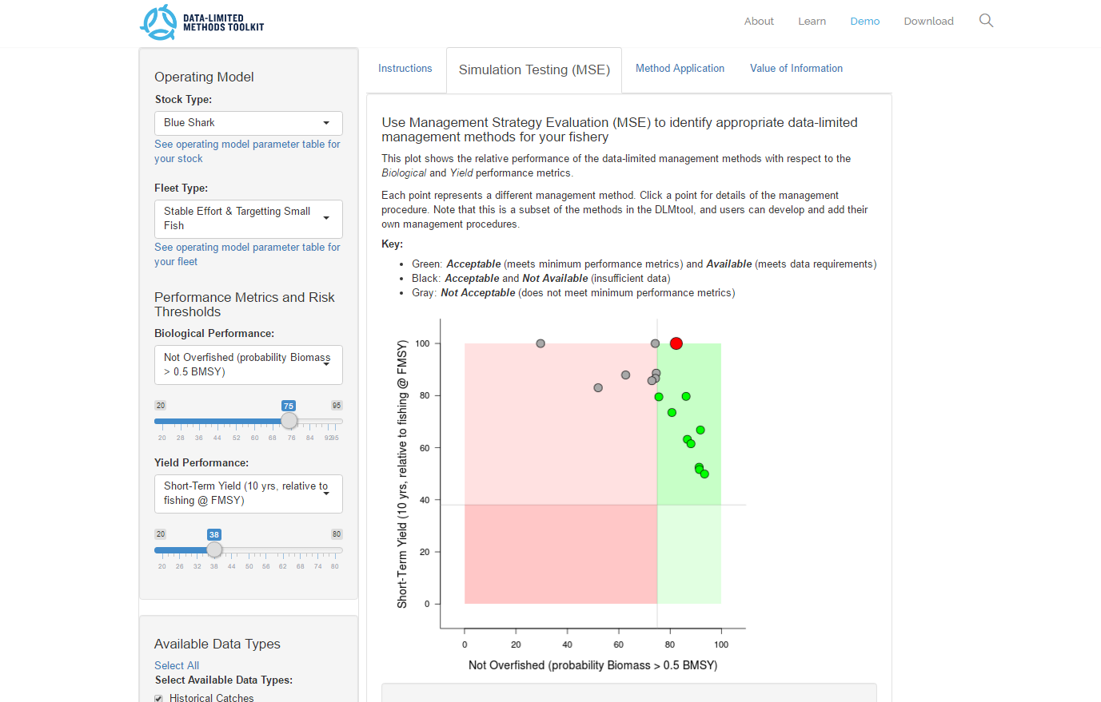
Online demo (www.datalimitedtoolkit.org/demo)

Slide 13
References
Costello, C. et al. 2012.Status and solutions for the world’s unassessed fisheries. Science 338, 517–520.
Nakatsuka, S. 2016. Management strategy evaluation in regional fisheries management organizations − How to promote robust fisheries management in international settings. Fisheries Research. DOI: 10.1016/j.fishres.2016.11.018
Punt, A.E., et al. 2016.Management strategy evaluation: best practices. Fish Fish. 17, 303–334, http://dx.doi.org/10.1111/faf.12104.
SEDAR, 2015. SEDAR 46: U.S. Caribbean Data-Limited Species. SouthEast Data, Assessment, and Review (SEDAR) 23. http://sedarweb.org/sedar-46.
SEDAR, 2016. Stock assessment report: Gulf of Mexico Data-limited species. Gulf of Mexico Fishery Management Council. SEDAR 49. http://sedarweb.org/sedar-49-final-stock-assessment-report-gulf-mexico-data-limited-species.

